Slide 1
Large-scale Real-Time Visualization System
For … Large number of people such as live performance
Can…
Organizer can composite motion movie and reflect it for user in real-time.
In some cases, it can reflect user’s response.
Acquiring user’s precise position and displaying an image on all smartphones as one large display.

Slide 2
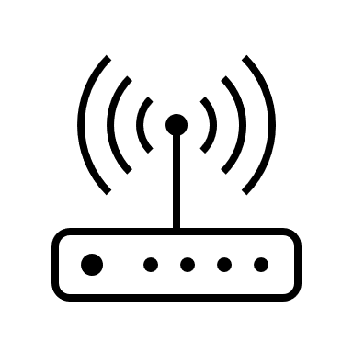




Stage
Construct high speed Wi-Fi mesh network.
Connect all smartphones for high speed Wi-Fi.
Precise all users position by using FTM technology.
Floor

Slide 3


Displaying an image on all smartphones as one large display.
Precising
Precising
Precising
Precising

